Slide 1
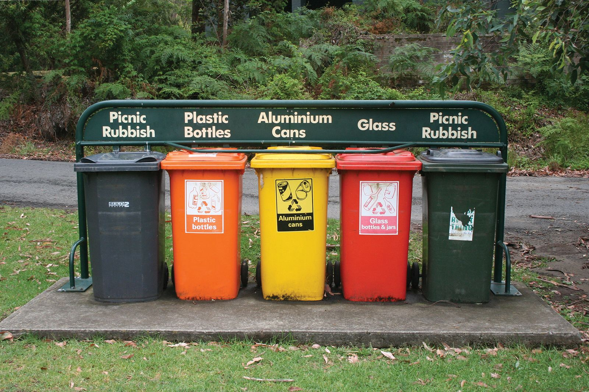
Garbage classification

Slide 2

Where is the data from?
https://www.kaggle.com/datasets/asdasdasasdas/garbage-classification
The Garbage Classification Dataset contains images categorized into six classes:
Cardboard: 393 images
Glass: 491 images
Metal: 400 images
Paper: 584 images
Plastic: 472 images
Trash: 127 images
Lets take a look at the images!

Slide 3
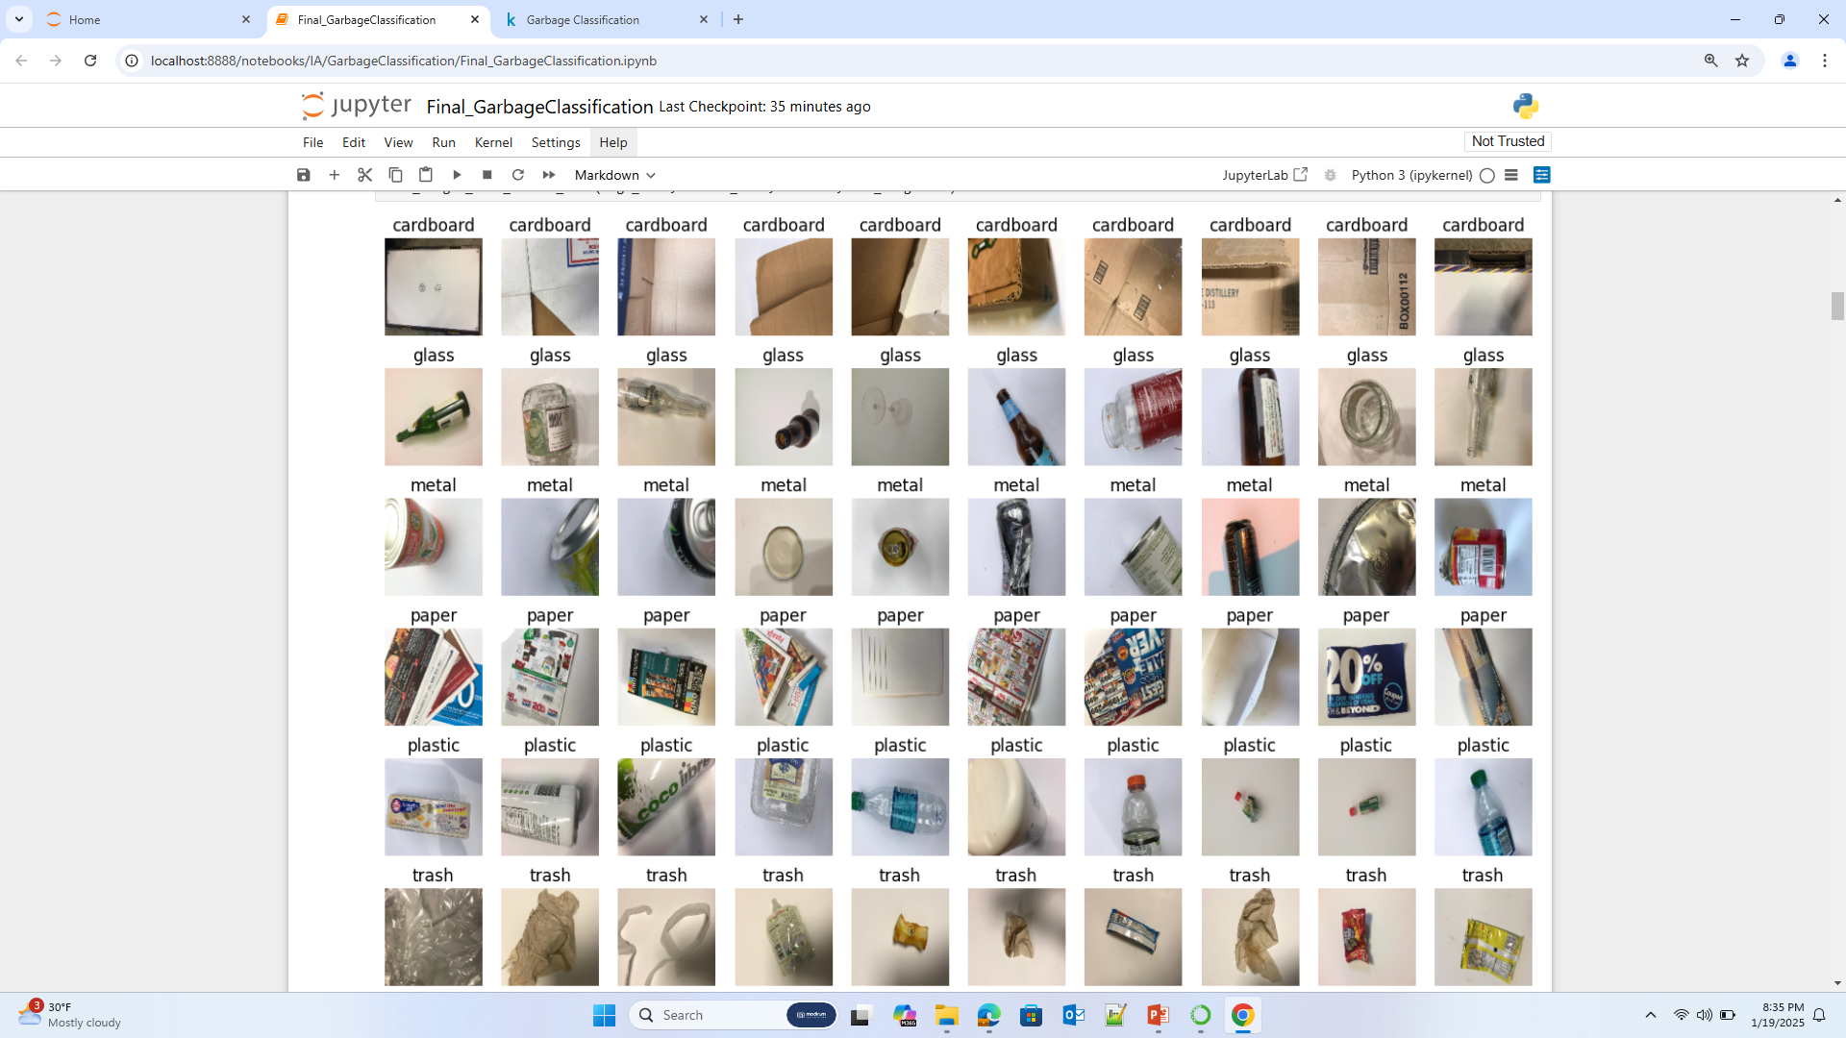

Slide 4
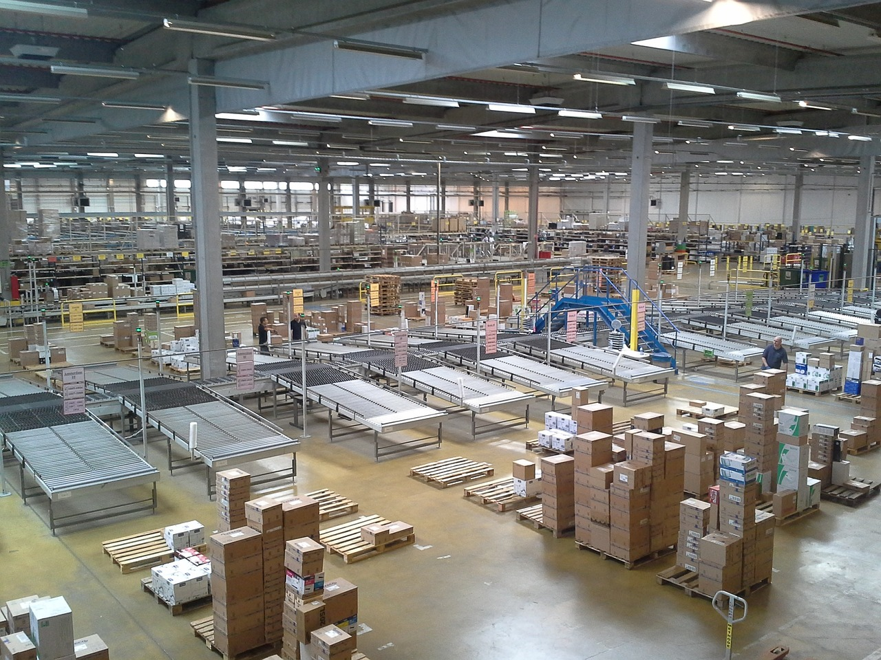
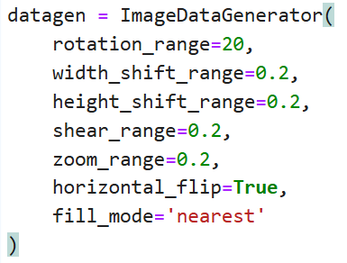
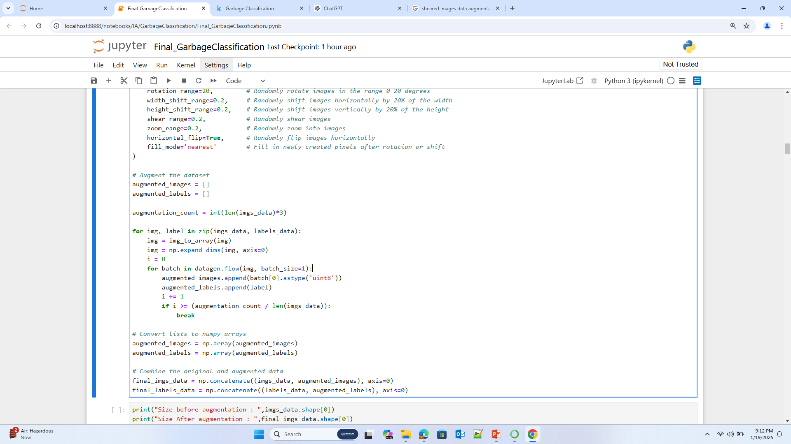




Data Augmentation
Properties
Rotation
Width shift
Height shift
Shear
Zoom
Horizontal flip
Fill
How to fill the empty pixels ?

Slide 5
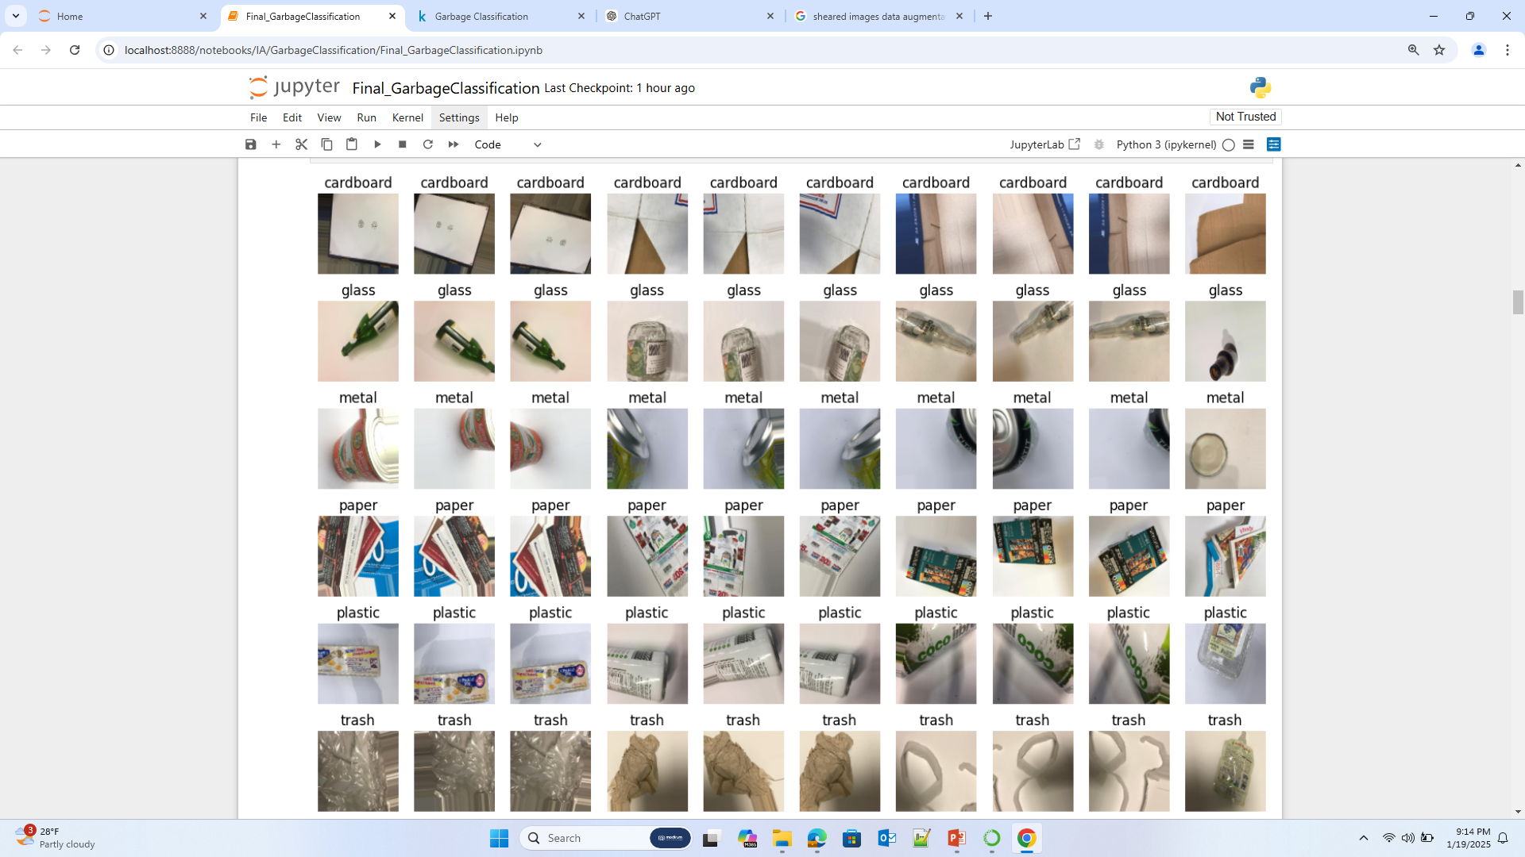

Slide 6

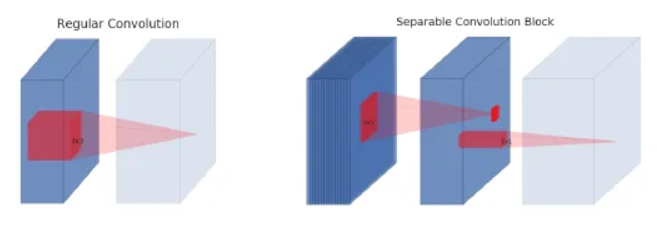
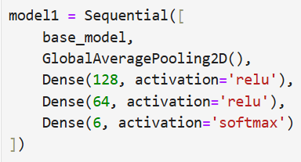
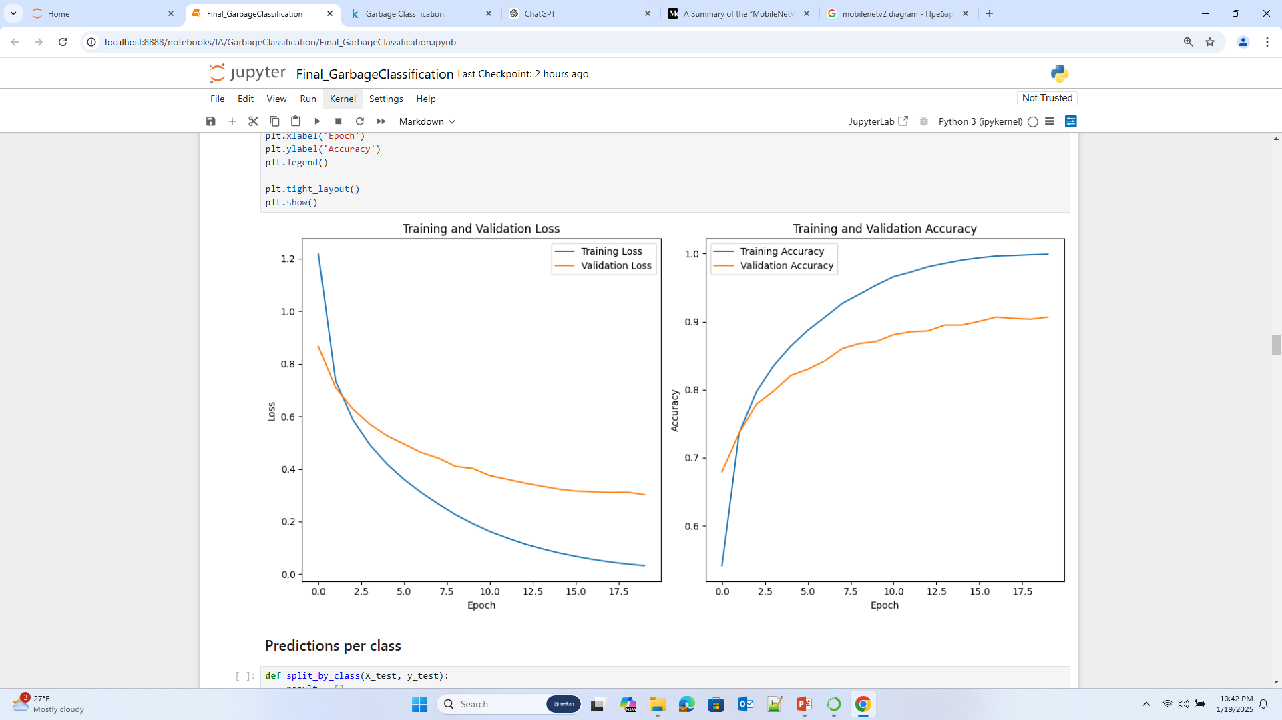
First model: Transfer Learning with MobileNetV2
MobileNetV2 is a model, made by Google Engineers and its purpose is to give excellent efficiency to performance ratio. It is meant for devices with less computational power. This is done by using separable convolutions. It consists of two steps: depth wise convolution (which operates on each input channel separately) and pointwise convolution (which combines the outputs from the depth wise step).
The base_model is a completely frozen MobileNetV2 convolutional base.
Test Accuracy:
0.8877348899841309

Slide 7
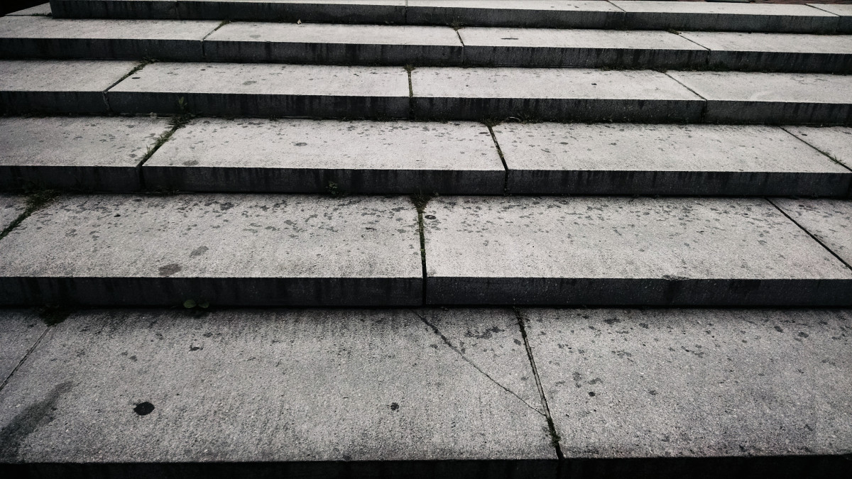
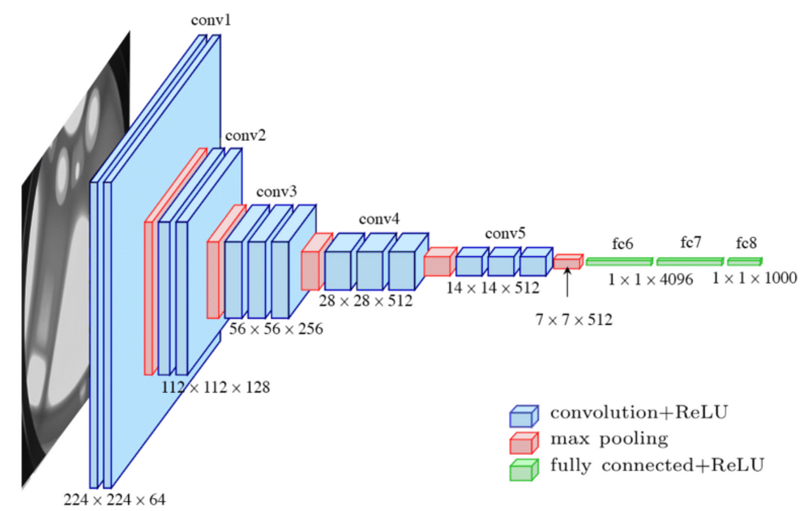
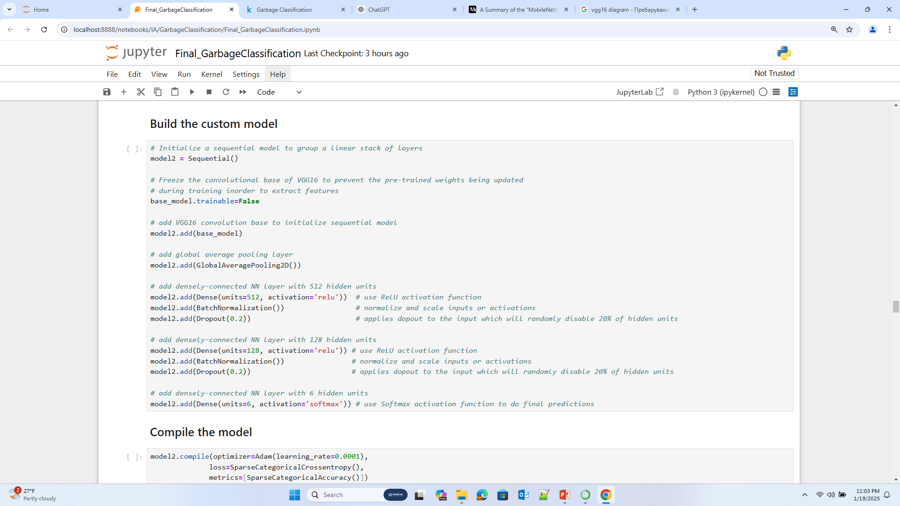
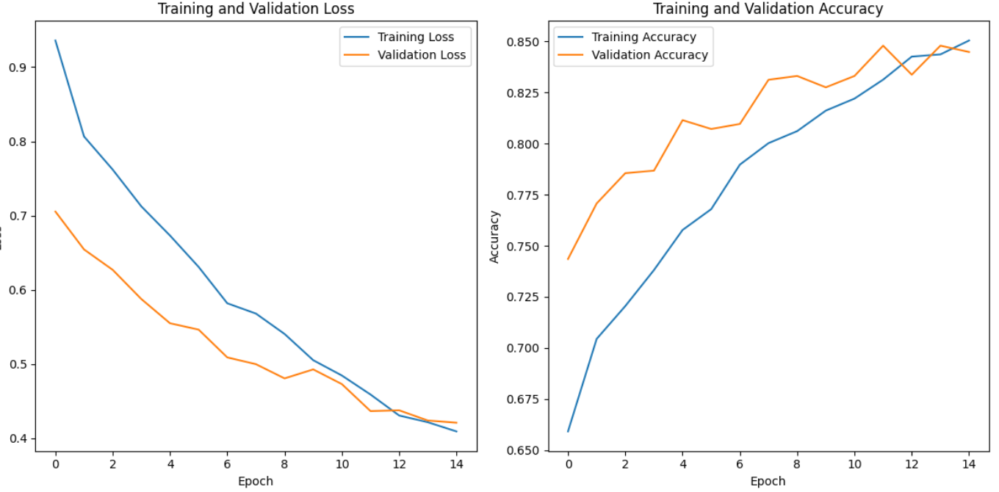
Second model: Transfer Learning with VGG16
In contrast, VGG16 was created with 16 neural layers to explore the effect of deep architectures on performance and to push the limits of what was possible. Its design is simple, but very repetitive thus very computationally expensive.
Test accuracy:
0.8412463068962097

